Slide 1
Design Pattern (Object Oriented Programming → Part 1)
Name: Sheikh Thanbir Alam
Deg: Senior Software Programmer
Org: Army War Game Center, BD Army

Slide 2
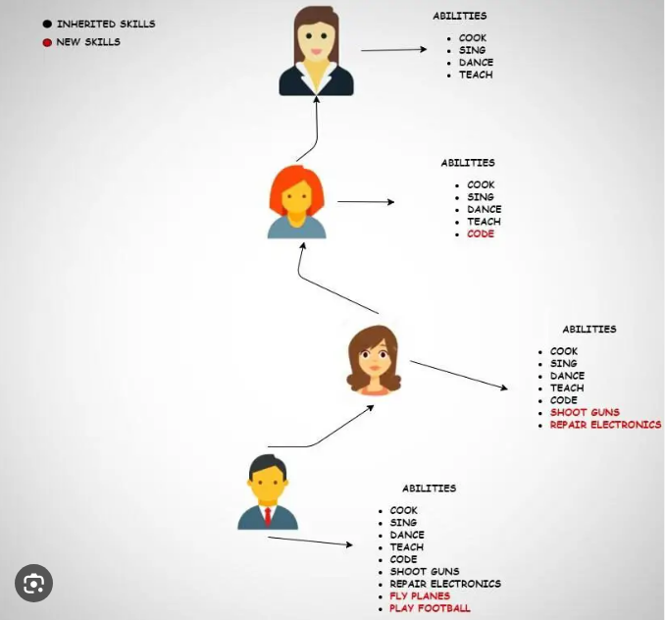
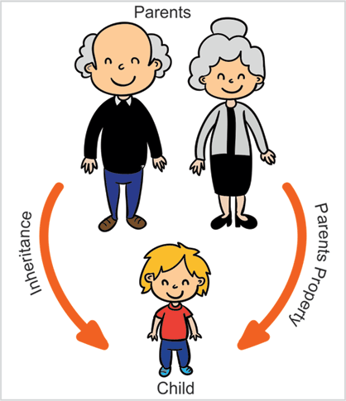
Inheritance

Slide 3
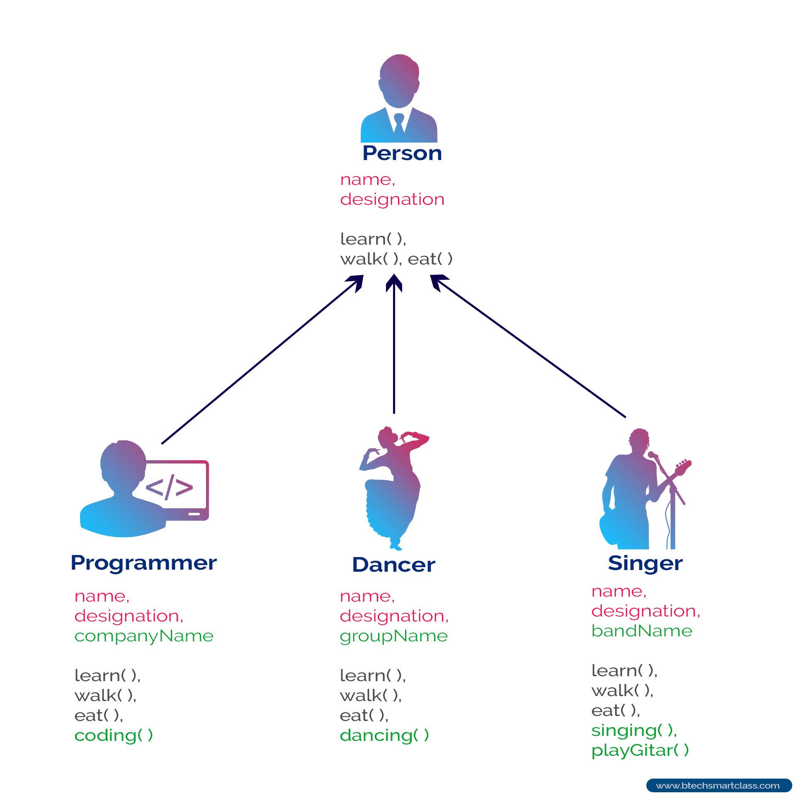
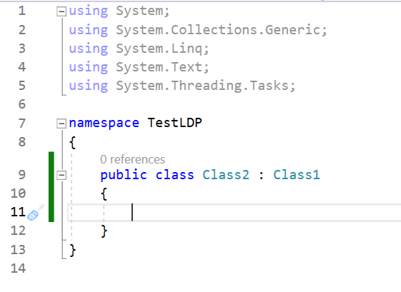
Programming Point of View

Slide 4
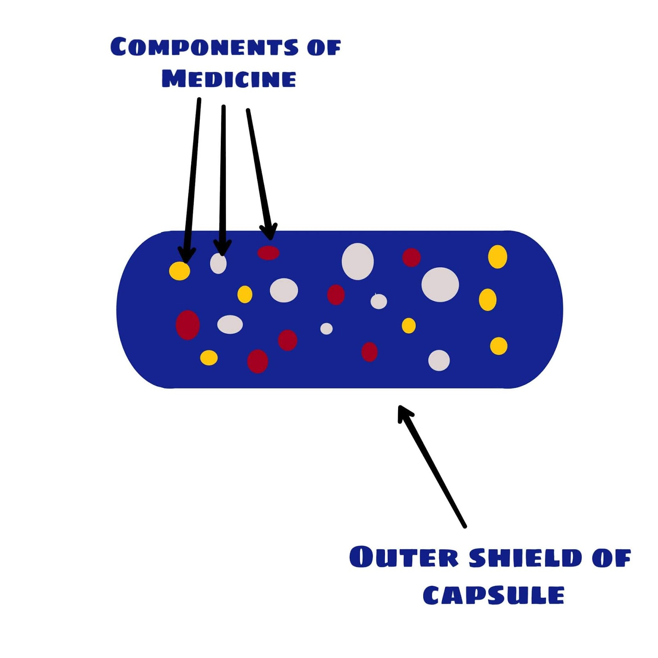
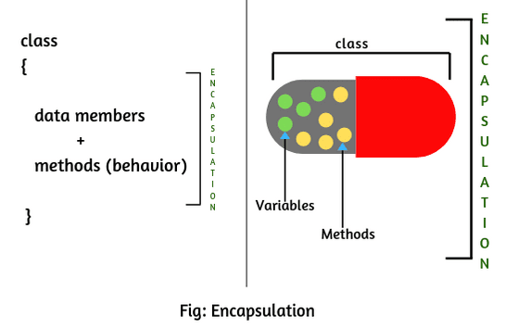
Encapsulation
In software systems, encapsulation refers to the bundling of data with the mechanisms or methods that operate on the data. It may also refer to the limiting of direct access to some of that data, such as an object's components

Slide 5
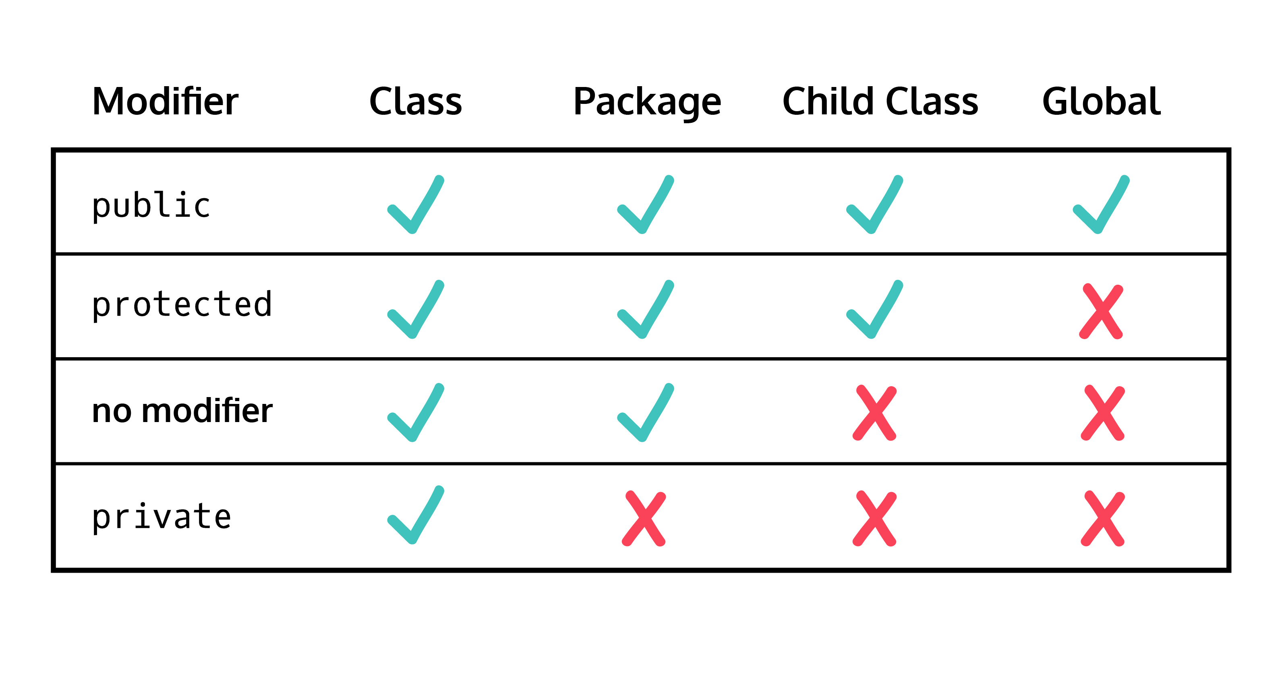

Slide 6
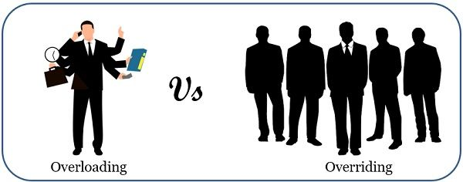
polymorphism

Slide 7
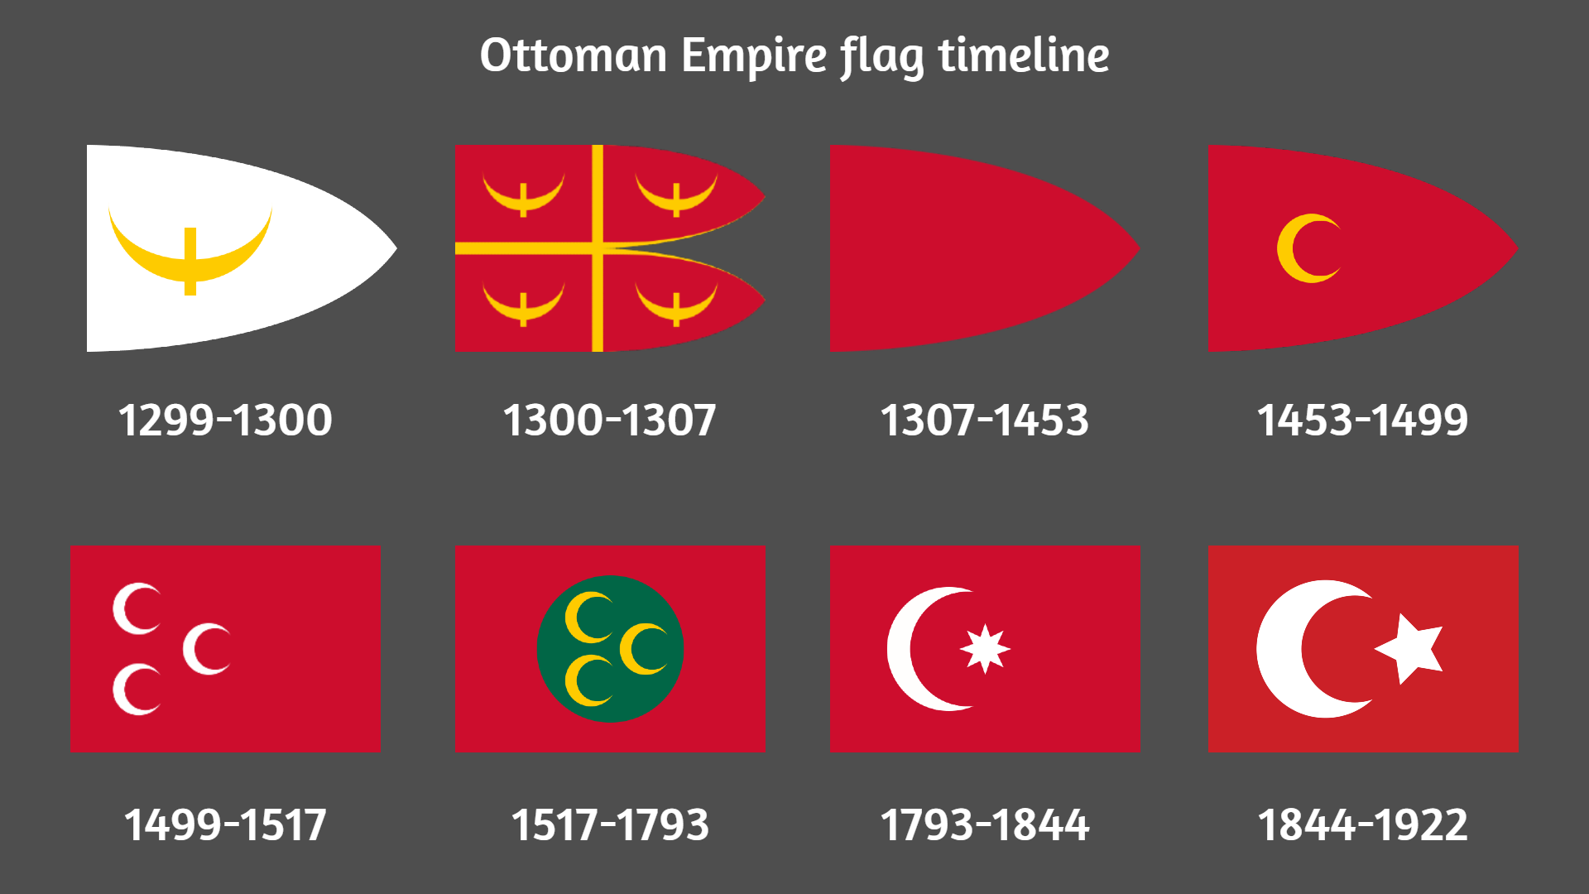

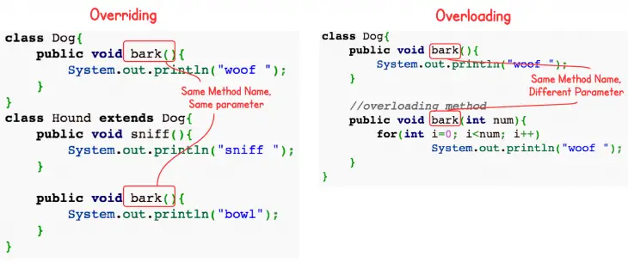

Slide 8


